Slide 1


DIGITIZING HUMAN CAPABILITY DEVELOPMENT
A PAKISTAN PERSPECTIVE
HIBA HASSAN
MSc Public Policy Management
Data Analytics

Slide 2
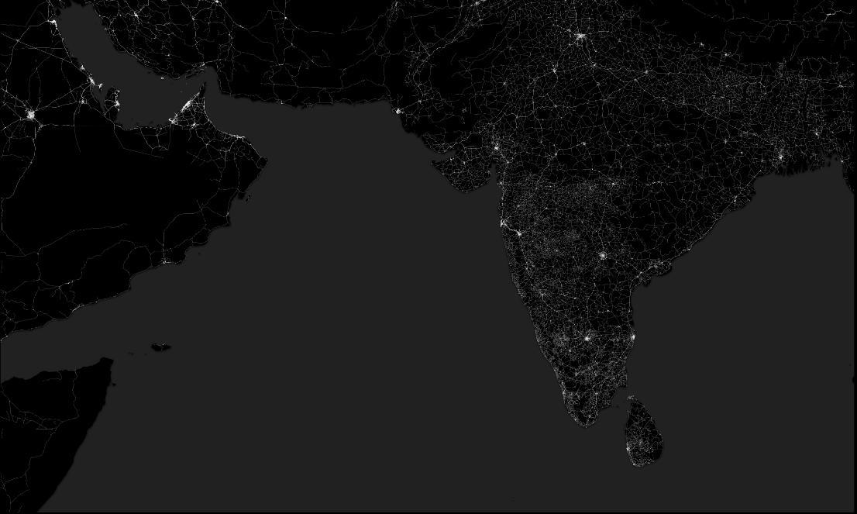
AGENDA
Logo here
CURRENT STATE OF HUMAN DEVELOPMENT
REDEFINING THE DEVELOPMENT NARRATIVE
ROAD TOWARDS PROGRESS
Subtitle
Date

Slide 3
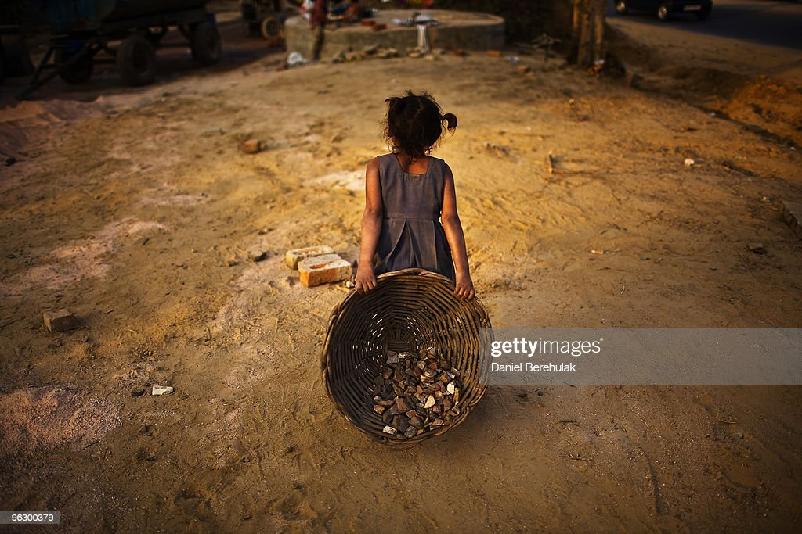
IMAGINE THIS
YOU ARE A 14-YEAR-OLD
ONLY COMPLETED SCHOOLING TILL GRADE 5
DO YOU THINK YOU CAN SURVIVE LIKE THIS FOR THE NEXT 20 YEARS?
WORKING UPTO 10 HOURS A DAY
A PIECE OF FLATBREAD IS THE ONLY MEAL YOU HAVE FOR THE DAY
Image Source: getty images

Slide 4
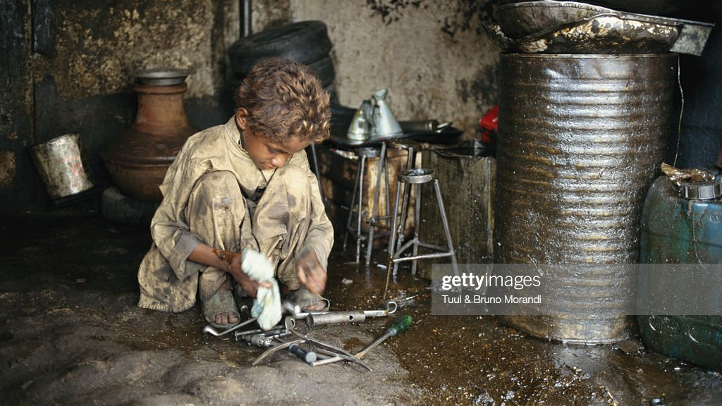
THE CURRENT
HUMAN DEVELOPMENT PARADIGM
Pakistan: Boy cleaning tools
Image Source: getty images

Slide 5

KEY STATISTICS
2
+
Rank 161
Out of 192 on the HDI(2022)
30%
Youth illiterate
70%
Quitting education to transition into informal job sector
4.4%
Unemployment Rate(2021)
Zubairi, A. “Pakistan Digital Learning Landscape Analysis” [Technical Report]. EdTech Hub.
THE CURRENT
THE PROPOSAL
WAY FORWARD
Notes:
Fix this slide

Slide 6

REDEFINING THE DEVELOPMENT NARRATIVE
Image Source: Superhands Charity

Slide 7

DIGITIZED PLATFORM FOR HUMAN DEVELOPMENT
2
+
S
E
E
SKILLSETS
EDUCATION
EMPLOYMENT
People’s Capabilities → Lifelong Learning
Training and Education Institutions
Decent and Sustainable work
UNDP Pakistan(2022),”Development Advocate Pakistan: Future of Work”
THE CURRENT
THE PROPOSAL
WAY FORWARD
Notes:
Fix this slide

Slide 8
2
+
PROJECT TIMELINE
NEED ANALYSIS
DIGITIZED TOOL
DEPLOY THE TOOL
REFINE AND EXPAND
1
2
3
4
PRIMARY RESEARCH/SURVEYS
IDENTIFY TARGET COMMUNITIES
CURRENT INFRASTRUCRURE
CUSTOMISED MODEL BASED ON SOCIO-ECONOMIC DIMENSIONS
GLOBAL EXPERT CONTRIBUTION FOR DEVELOPING TRAININGS
MODEL TRIAL ON SELECTED COMMUNITY
FEEDBACK ANALYSIS
REFINEMENT BASED ON FEEDBACK
PAKISTAN AND OTHER DEVELOPING COUNTRIES
THE CURRENT
THE PROPOSAL
WAY FORWARD
Notes:
Add impact of each

Slide 9




PUBLIC-PRIVATE PARTNERSHIPS
2
+
Global Partnership for Education
Ministry of Federal Education and Professional Training, Pakistan
Ministry of Information Technology and Communication, Pakistan
Aga Khan Development Network
THE CURRENT
THE PROPOSAL
WAY FORWARD
Notes:
Fix this slide

Slide 10

FUNDING
2
+
Development of
the tool
$30,000-$40,000
Research and Deployment
$20,000
Total
$60,000-$70,000
THE CURRENT
THE PROPOSAL
WAY FORWARD
Notes:
Fix this slide

Slide 11
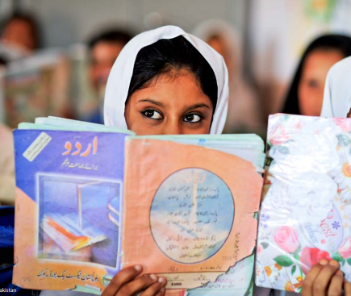
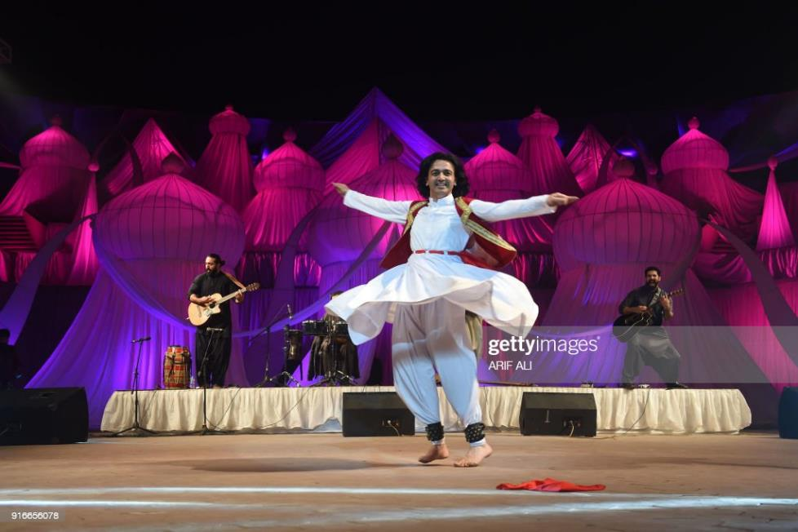
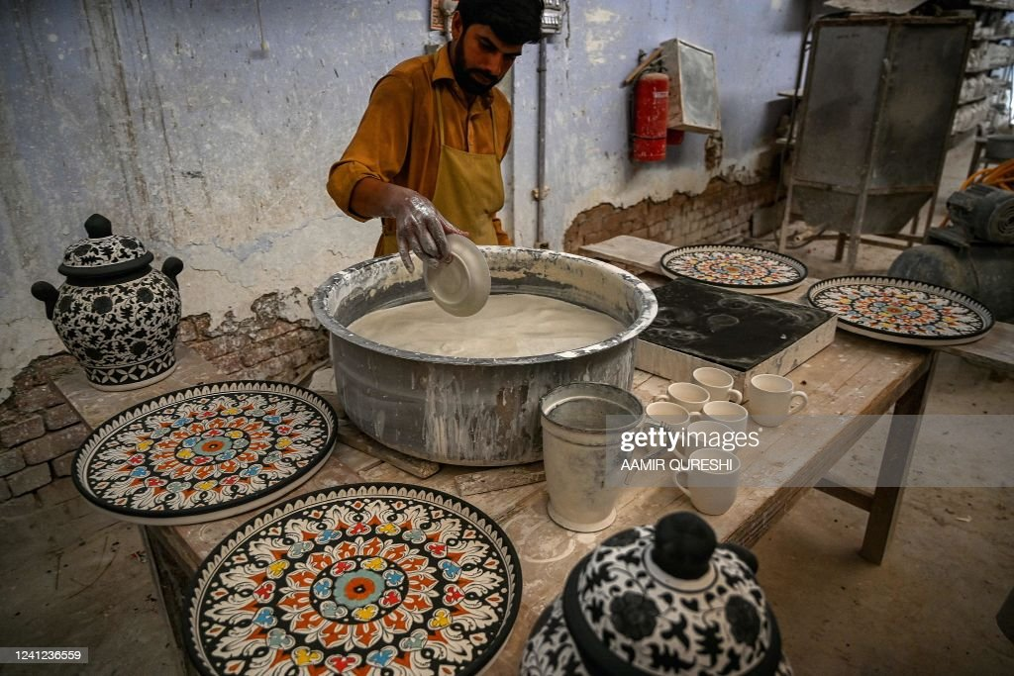
IMAGE SOURCE:UNDP, PAKISTAN
ROAD TOWARDS PROGRESS

Slide 12
2
+
“
THERE IS NO ‘ONE SIZE FITS ALL’ APPROACH TO BRIDGE THE SKILL-GAP AND DEVISE A FORWARD-LOOKING STRATEGY.
DIGITAL RESKILLING AND CAPACITY BUILDING MUST BE TAILORED TO A VARIETY OF INDIVIDUAL AND SOCIETAL CONTEXTS.
”
--TARIQ MALIK,CHAIRMAN NADRA, PAKISTAN

Slide 13
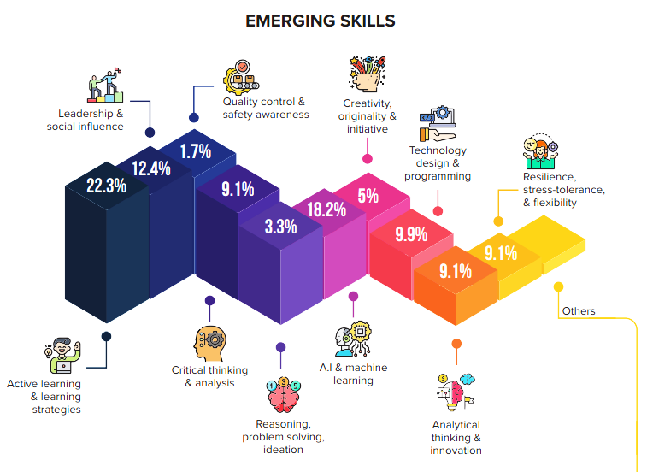

EXPECTED RESULTS
2
+
UNIQUELY TAILORED SKILL-DEVELOPPMENT PROGRAMS
UNDP Pakistan(2022),”Development Advocate Pakistan: Future of Work”
THE CURRENT
THE PROPOSAL
WAY FORWARD
Notes:
Fix this slide

Slide 14
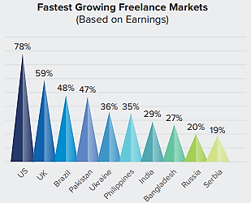

EXPECTED RESULTS
2
+
GIG-ECONOMY DEVELOPMENT
In 2021, Pakistan generated an amount of
USD 500 million
entirely from freelancing.
UNDP Pakistan(2022),”Development Advocate Pakistan: Future of Work”
THE CURRENT
THE PROPOSAL
WAY FORWARD
Notes:
Fix this slide

Slide 15
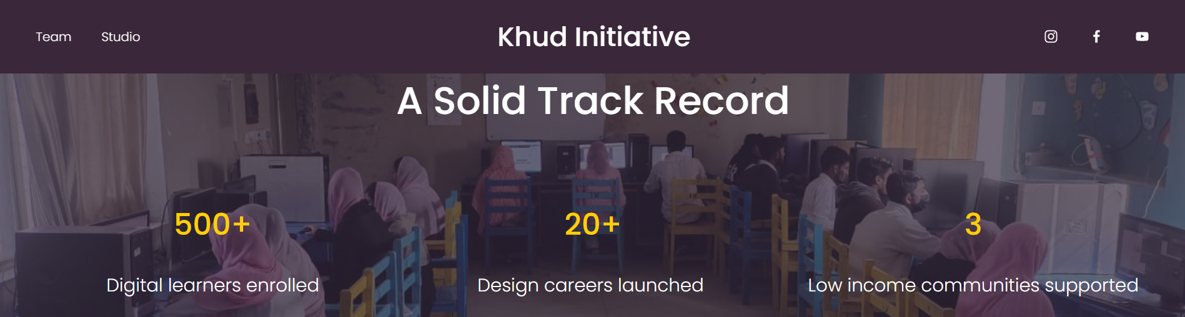

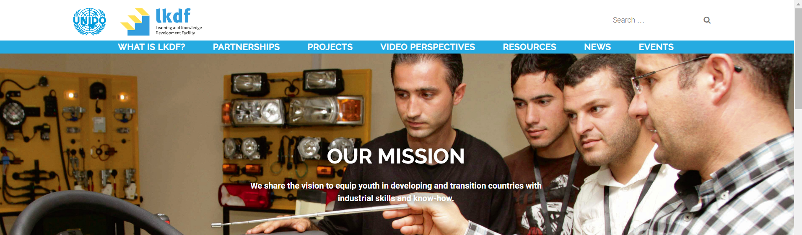
EXPECTED RESULTS
2
+
ENHANCE IMPACT OF EXISTING, SIMILAR MODELS
Khud.org, Learning and Knowledge Development Facility, UNIDO
THE CURRENT
THE PROPOSAL
WAY FORWARD
Notes:
Fix this slide

Slide 16

ARE YOU READY TO INVEST INTO A REFINED FUTURE OF PAKISTAN?
IMAGE SOURCE: adobe stock

Slide 17
THANKYOU
QUESTIONS AND ANSWERS
HIBA HASSAN
MSc Public Policy Management
Data Analytics

